Slide 1
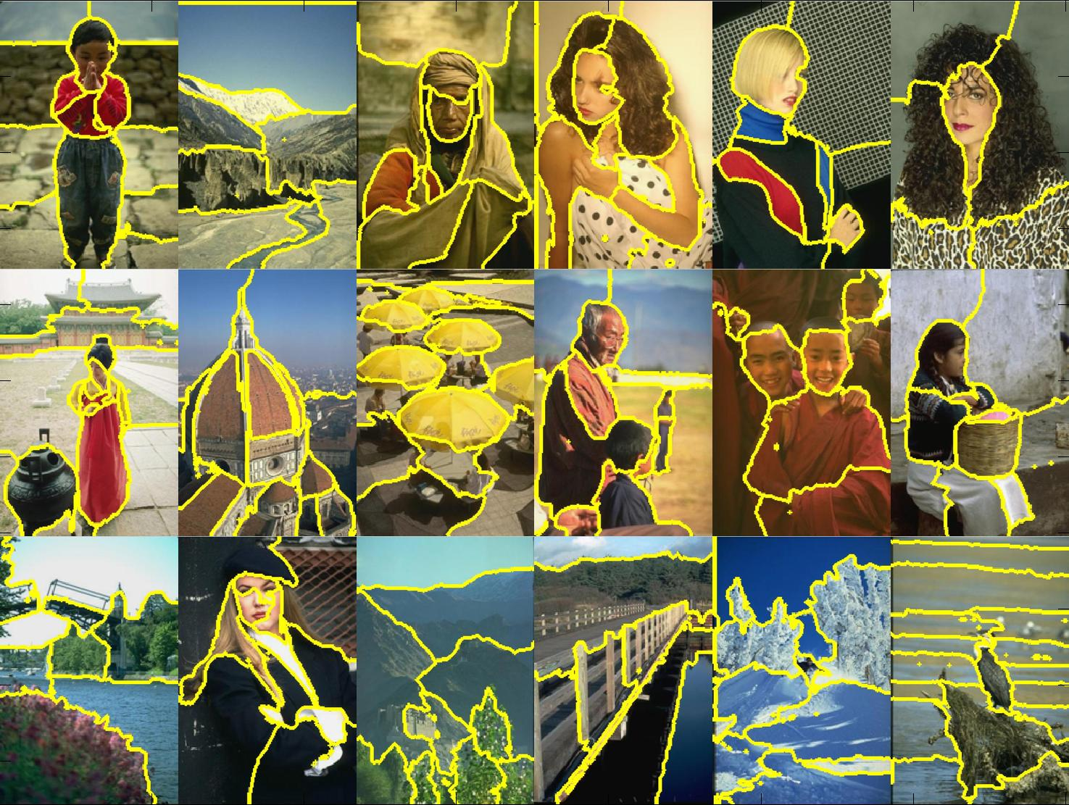
Segmentation & Custering
Disclaimer: Many slides have been borrowed from Devi Parikh and Kristen Grauman, who may have borrowed some of them from others. Any time a slide did not already have a credit on it, I have credited it to Kristen. So there is a chance some of these credits are inaccurate.
Notes:
1

Slide 2
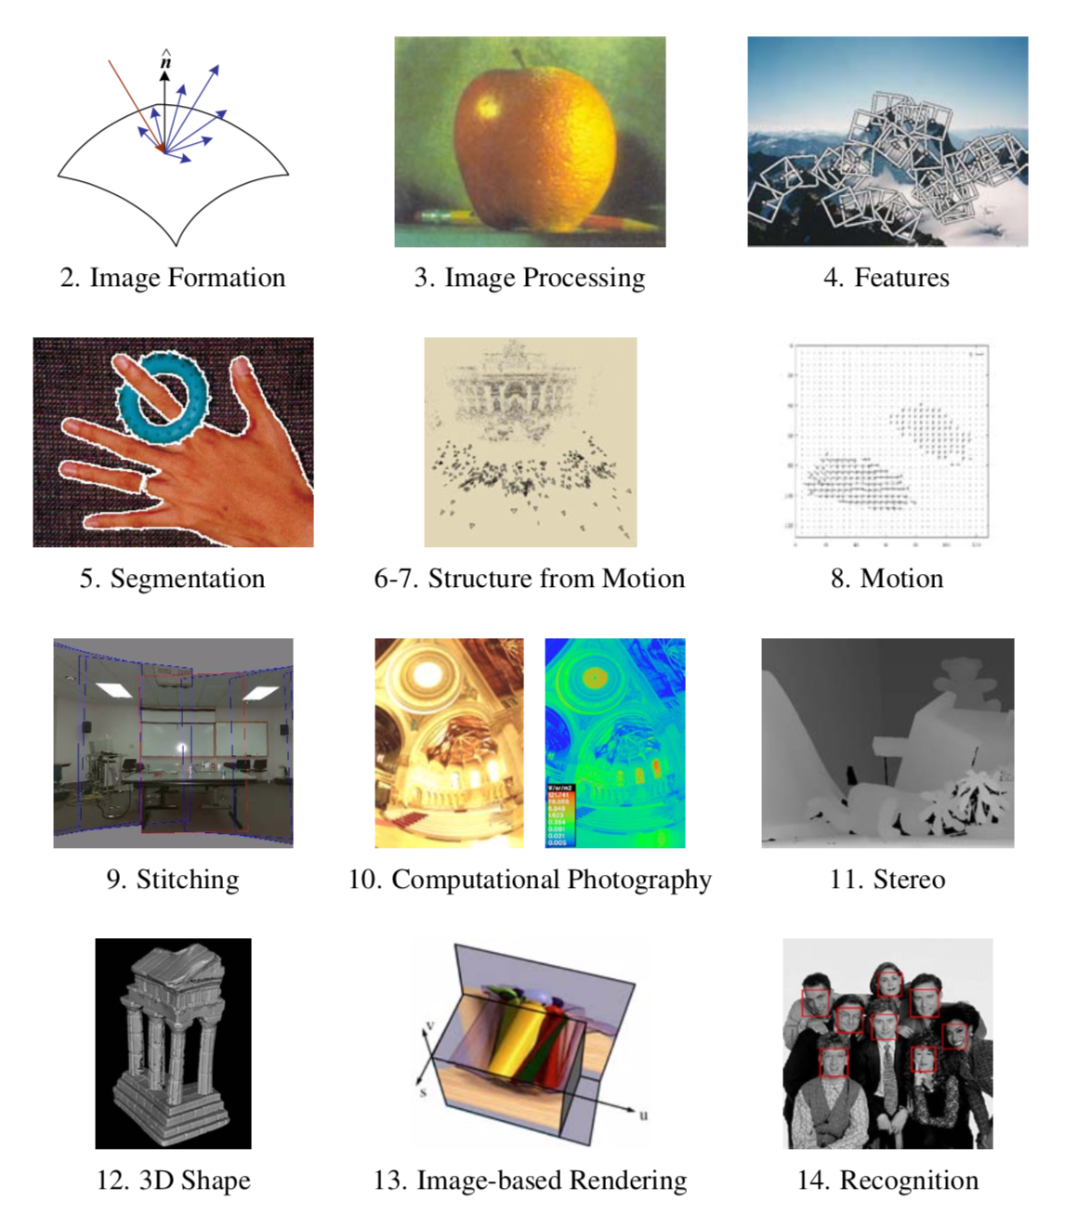

Slide 5
Grouping in vision
Goals:
Gather features that belong together
Obtain an intermediate representation that compactly describes key image or video parts
Slide credit: Kristen Grauman

Slide 6
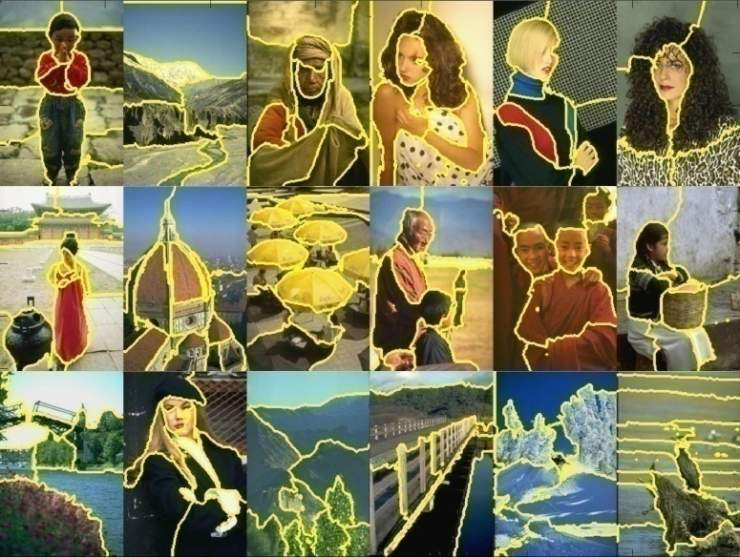
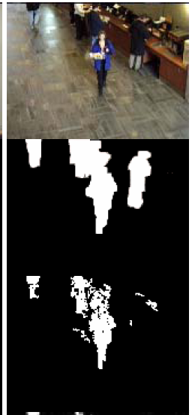
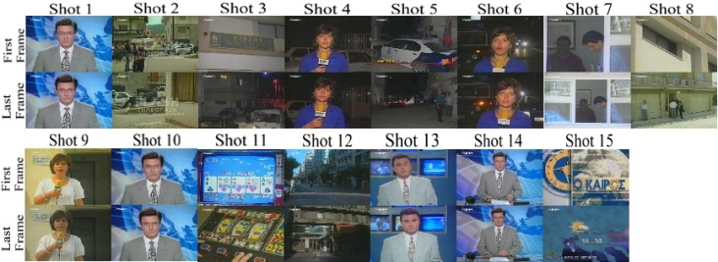
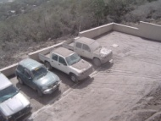
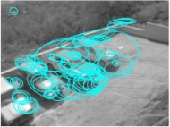
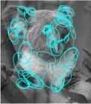
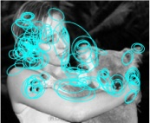
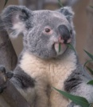
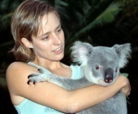
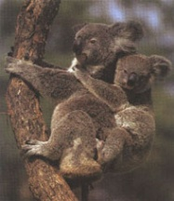
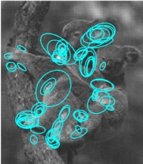
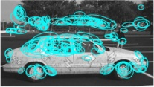
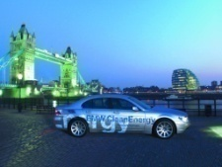
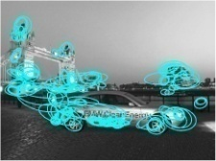



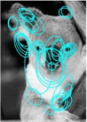
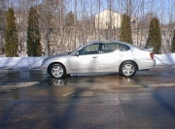
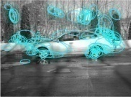
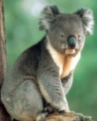
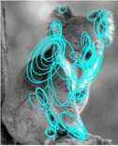
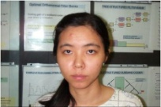
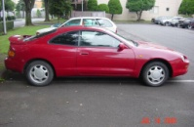
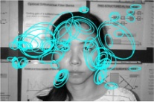
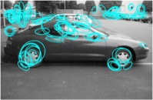
Examples of grouping in vision
[http://poseidon.csd.auth.gr/LAB_RESEARCH/Latest/imgs/SpeakDepVidIndex_img2.jpg]
Group video frames into shots
[Figure by J. Shi]
Determine image regions
Fg / Bg
[Figure by Wang & Suter]
Figure-ground
[Figure by Grauman & Darrell]
Object-level grouping
Slide credit: Kristen Grauman
Notes:
6

Slide 7
Grouping in vision
Goals:
Gather features that belong together
Obtain an intermediate representation that compactly describes key image (video) parts
Top down vs. bottom up segmentation
Top down: pixels belong together because they are from the same object
Bottom up: pixels belong together because they look similar
Hard to measure success
What is interesting depends on the application.
Slide credit: Kristen Grauman

Slide 8
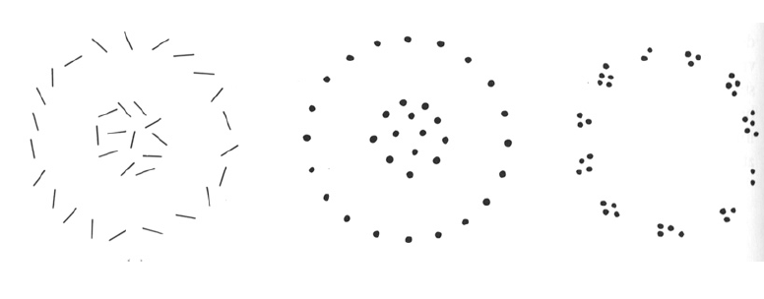
Slide credit: Kristen Grauman

Slide 9
Gestalt
Gestalt: whole or group
Whole is something other than sum of its parts
Relationships among parts can yield new properties/features
Psychologists identified series of factors that predispose set of elements to be grouped (by human visual system)
Slide credit: Kristen Grauman
Notes:
9

Slide 10
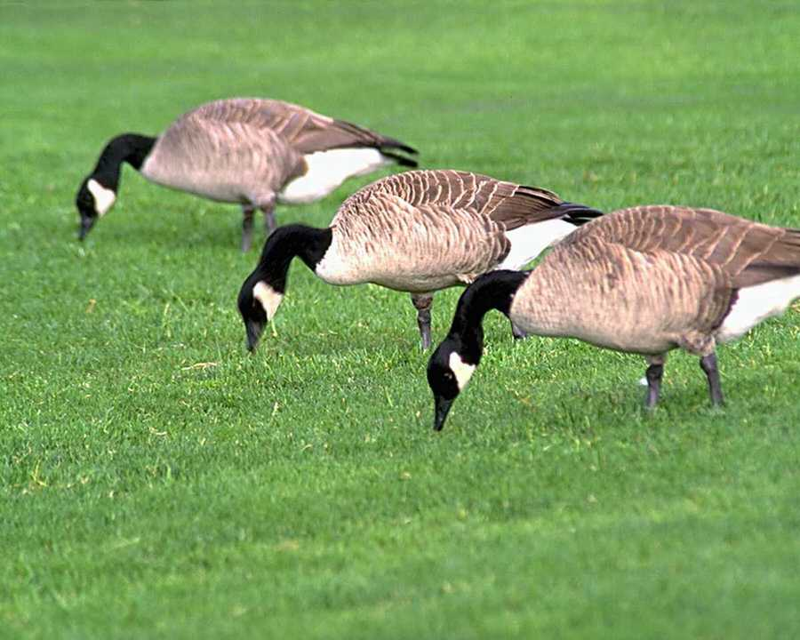
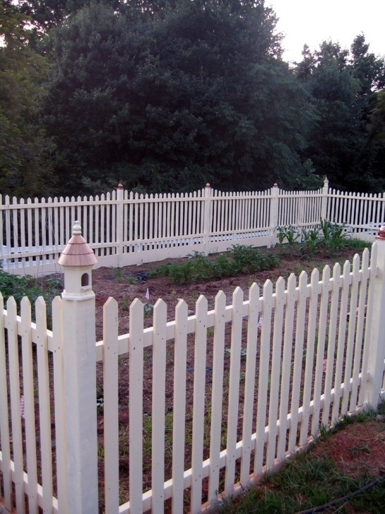
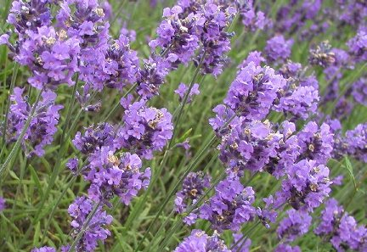
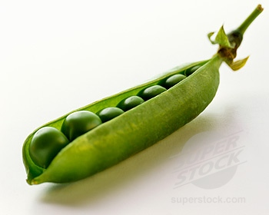
Similarity
Kristen Grauman
http://chicagoist.com/attachments/chicagoist_alicia/GEESE.jpg, http://wwwdelivery.superstock.com/WI/223/1532/PreviewComp/SuperStock_1532R-0831.jpg

Slide 11
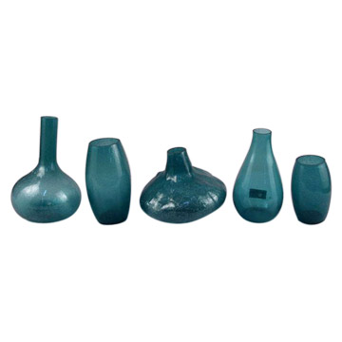
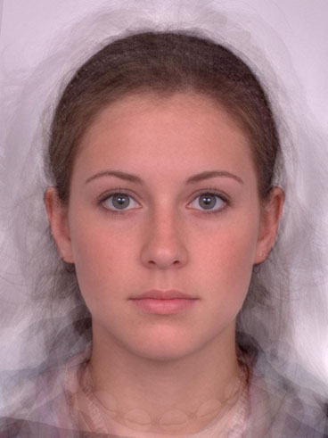
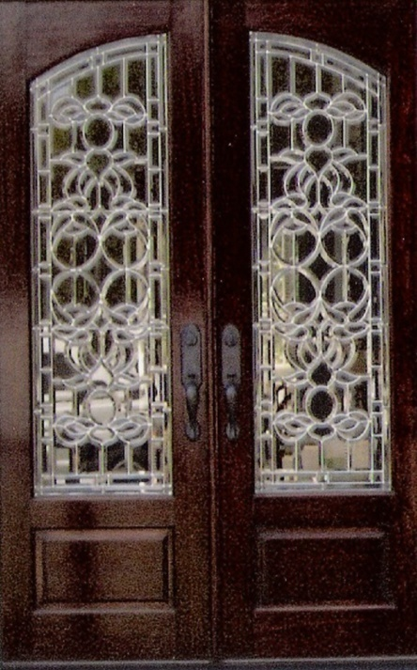
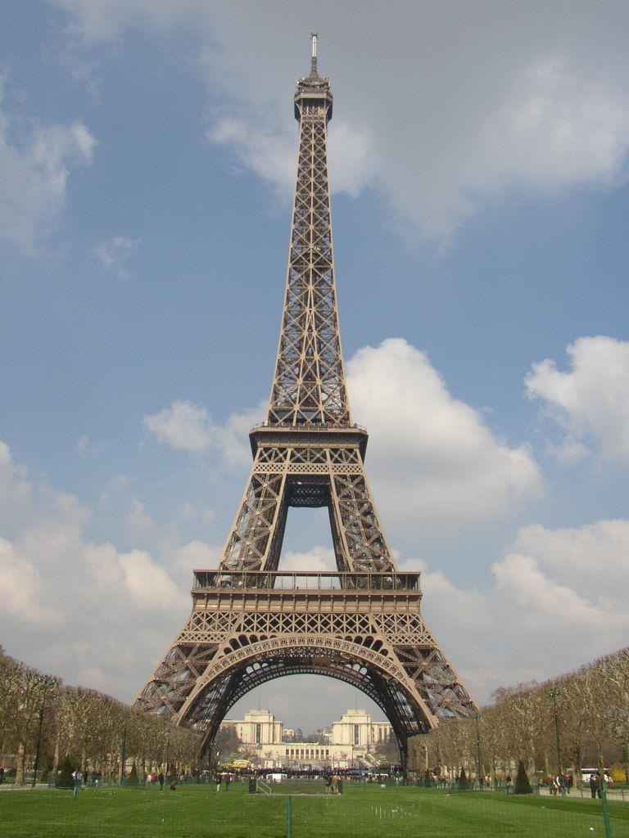
Symmetry
Slide credit: Kristen Grauman
http://seedmagazine.com/news/2006/10/beauty_is_in_the_processingtim.php

Slide 12
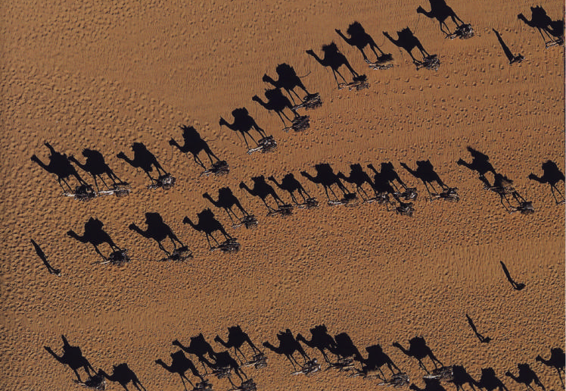
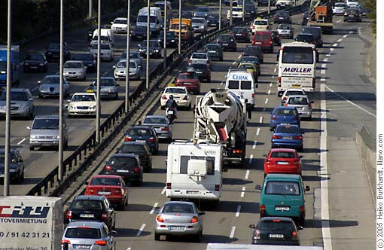
Common fate
Image credit: Arthus-Bertrand (via F. Durand)
(coherent motion)
Slide credit: Kristen Grauman

Slide 13
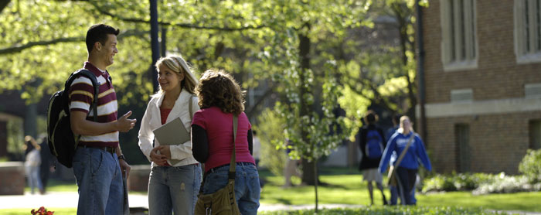
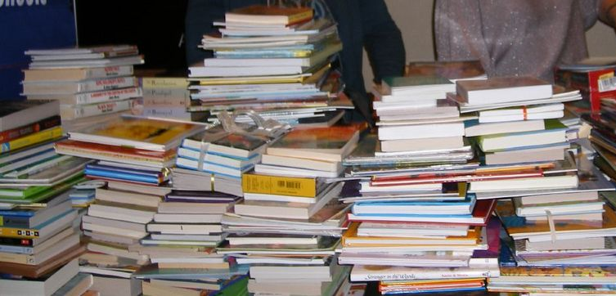
Proximity
Slide credit: Kristen Grauman
http://www.capital.edu/Resources/Images/outside6_035.jpg

Slide 14
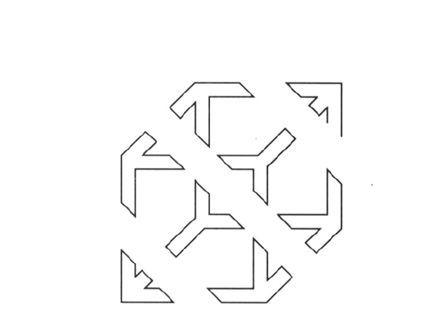
Slide credit: Kristen Grauman

Slide 15
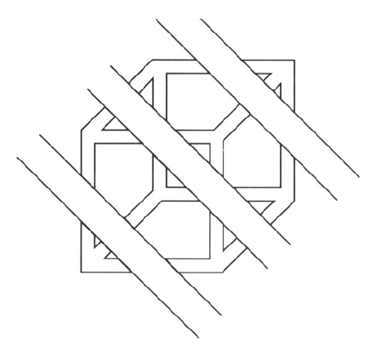
Continuity, explanation by occlusion
Slide credit: Kristen Grauman

Slide 16
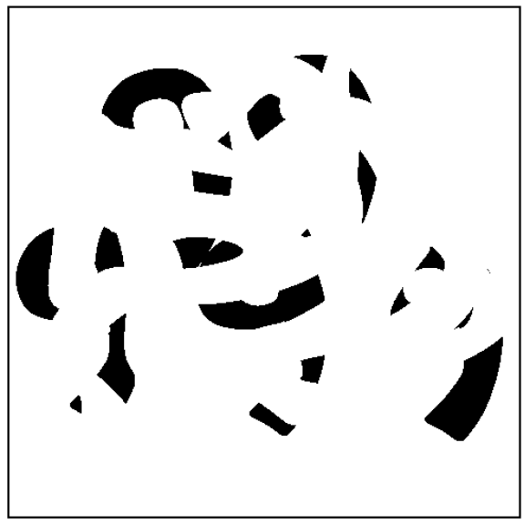
D. Forsyth

Slide 17
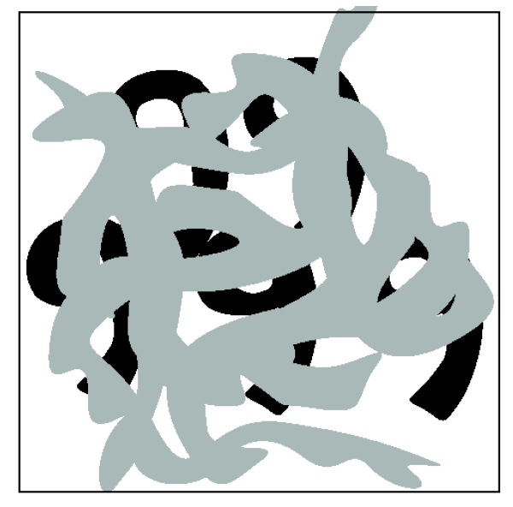
Slide credit: Kristen Grauman

Slide 18
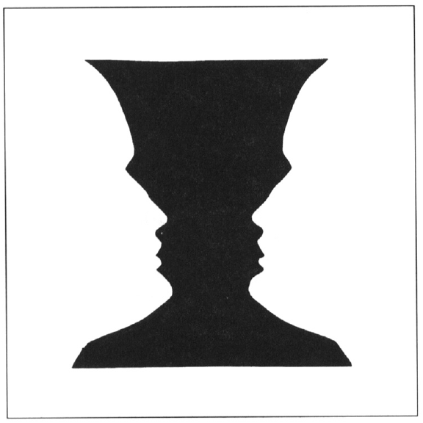
Figure-ground
Slide credit: Kristen Grauman

Slide 19
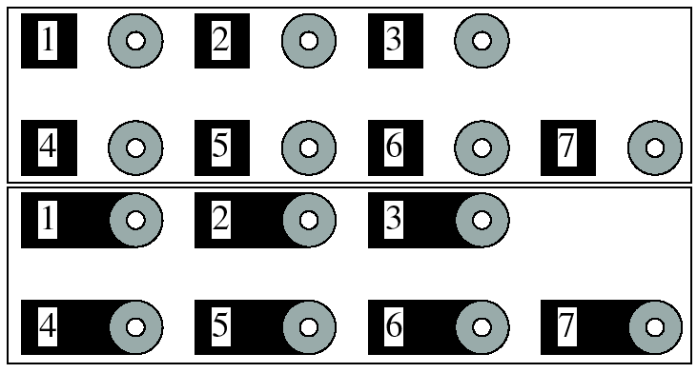
Grouping phenomena in real life
Forsyth & Ponce, Figure 14.7
Slide credit: Kristen Grauman

Slide 20
Grouping phenomena in real life
Forsyth & Ponce, Figure 14.7
Slide credit: Kristen Grauman

Slide 21
Gestalt
Gestalt: whole or group
Whole is other than sum of its parts
Relationships among parts can yield new properties/features
Psychologists identified series of factors that predispose set of elements to be grouped (by human visual system)
Inspiring observations/explanations; challenge remains how to best map to algorithms.
Slide credit: Kristen Grauman
Notes:
21

Slide 23
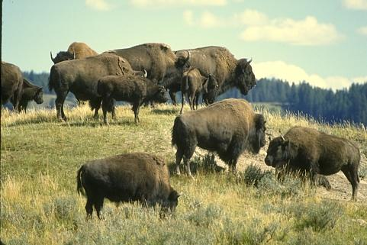
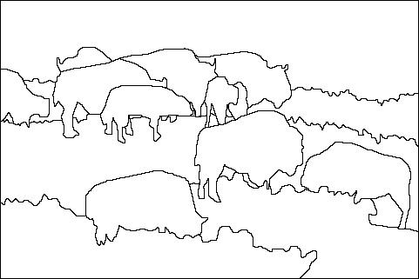

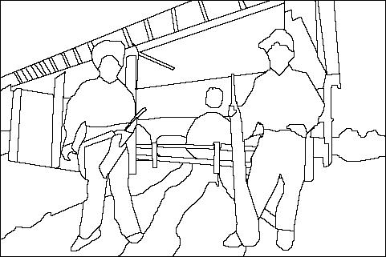
The goals of segmentation
Separate image into coherent “objects”
image
human segmentation
Source: Lana Lazebnik

Slide 24
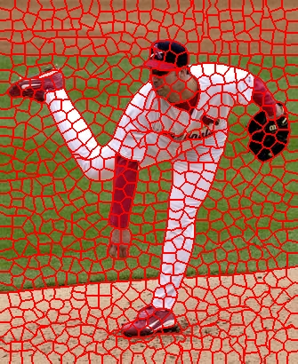
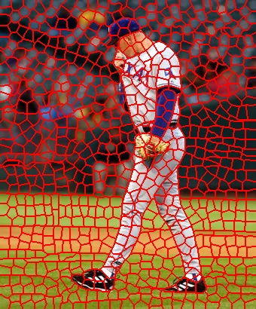
The goals of segmentation
Separate image into coherent “objects”
Group together similar-looking pixels for efficiency of further processing
“superpixels”
X. Ren and J. Malik. Learning a classification model for segmentation. ICCV 2003.
Source: Lana Lazebnik

Slide 25
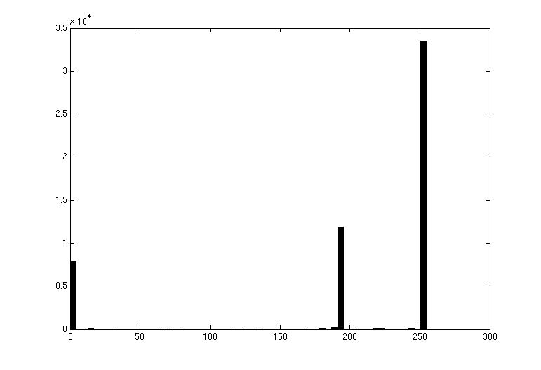

Image segmentation: toy example
white pixels
pixel count
3
black pixels
gray pixels
1
2
input image
intensity
These intensities define the three groups.
We could label every pixel in the image according to which of these primary intensities it is.
i.e., segment the image based on the intensity feature.
What if the image isn’t quite so simple?
Kristen Grauman

Slide 26


pixel count
input image
intensity
pixel count
input image
intensity
Kristen Grauman

Slide 27
pixel count
input image
intensity
Now how to determine the three main intensities that define our groups?
We need to cluster.
Kristen Grauman

Slide 28

K-means clustering
Basic idea: randomly initialize the k cluster centers, and iterate between the two steps we just saw.
Randomly initialize the cluster centers, c₁, ..., c_{K}
Given cluster centers, determine points in each cluster
For each point p, find the closest c_{i}. Put p into cluster i
Given points in each cluster, solve for c_{i}
Set c_{i} to be the mean of points in cluster i
If c_{i} have changed, repeat Step 2
Properties
Will always converge to some solution
Can be a “local minimum”
does not always find the global minimum of objective function:
Source: Steve Seitz

Slide 29


K-means: pros and cons
Pros
Simple, fast to compute
Converges to local minimum of within-cluster squared error
Cons/issues
Setting k?
Sensitive to initial centers
Sensitive to outliers
Detects spherical clusters
Assuming means can be computed
Slide credit: Kristen Grauman
Notes:
29

Slide 30

An aside: Smoothing out cluster assignments
Assigning a cluster label per pixel may yield outliers:
original
labeled by cluster center’s intensity
?
How to ensure they are spatially smooth?
3
1
2
Kristen Grauman

Slide 32

Segmentation as clustering
Depending on what we choose as the feature space, we can group pixels in different ways.
Grouping pixels based on intensity similarity
Feature space: intensity value (1-d)
Slide credit: Kristen Grauman
Notes:
32

Slide 33


K=2
K=3
quantization of the feature space; segmentation label map
Slide credit: Kristen Grauman

Slide 34

Segmentation as clustering
Depending on what we choose as the feature space, we can group pixels in different ways.
R=255
G=200
B=250
Grouping pixels based on color similarity
B
R=245
G=220
B=248
G
R=15
G=189
B=2
R=3
G=12
B=2
R
Feature space: color value (3-d)
Kristen Grauman
Notes:
34

Slide 35
Segmentation as clustering
Depending on what we choose as the feature space, we can group pixels in different ways.
Grouping pixels based on intensity similarity
Clusters based on intensity similarity don’t have to be spatially coherent.
Kristen Grauman
Notes:
35

Slide 36
Segmentation as clustering
Depending on what we choose as the feature space, we can group pixels in different ways.
Grouping pixels based on intensity+position similarity
Intensity
Y
X
Both regions are black, but if we also include position (x,y), then we could group the two into distinct segments; way to encode both similarity & proximity.
Kristen Grauman
Notes:
36

Slide 37



Segmentation as clustering
Color, brightness, position alone are not enough to distinguish all regions…
Slide credit: Kristen Grauman

Slide 39

Fully convolutional nets…
”Expand” trained network to any size
Long, J., Shelhamer, E., & Darrell, T. (2015). Fully convolutional networks for semantic segmentation. In CVPR 2014

Slide 40



…for segmentation
Complicated upsampling strategies…
Results not yet great
Long, J., Shelhamer, E., & Darrell, T. (2015). Fully convolutional networks for semantic segmentation. In CVPR 2014

Slide 41


U-Net
Builds on FCN, Contract-expand with skip…
Almost symmetric, many channels at bottom!
O. Ronneberger, P. Fischer, and T. Brox, “U-net: Convolutional networks for biomedical image segmentation,” in MICCAI, pp. 234–241, Springer, 2015.

Slide 42

Segnet
Adds…
Segnet: A deep convolutional encoder-decoder architecture for image segmentation
V Badrinarayanan, A Kendall, R Cipolla - PAMI 2017

Slide 43

Segnet
Eliminates need to learn the upsamplng
Segnet: A deep convolutional encoder-decoder architecture for image segmentation
V Badrinarayanan, A Kendall, R Cipolla - PAMI 2017

Slide 44
Mask-RCNN…
Neural networks to learn both local feature affinities and top-down context
He et al., “Mask R-CNN,” ICCV 2017 (Best paper)

Slide 45

Mask-RCNN…
Results
He et al., “Mask R-CNN,” ICCV 2017 (Best paper)

Slide 46

“Panoptic” Segmentation
Segnet = semantic segmentation (every pixel)
Mask-RCNN = instance segmentation (ojects)
Panoptic = combined
Alexander Kirillov, Kaiming He, Ross Girshick, Carsten Rother, and Piotr Dollár. Panoptic segmentation. In CVPR, 2019

Slide 47


Panoptic Feature Pyramid Networks
Uses FPN architecture
2 heads
Alexander Kirillov, Kaiming He, Ross Girshick, Carsten Rother, and Piotr Dollár. Panoptic Feature Pyramid Networks. In CVPR, 2019

